Slide 1
Single Trace Electromagnetic Side-Channel Attacks on FPGA Implementation of ^{Elliptic Curve Cryptography}
Prasanna Ravi^{1,2}, Bernhard Jungk³, Shivam Bhasin¹
¹School of Computer Science and Engineering, Nanyang Technological University
²Temasek Laboratories @ Nanyang Technological University
³Independent Researcher
7th June, 2019

Slide 2
Outline:
Context and Background
Attack Methodology
Attack target Details
Attacking Algorithmic countermeasures
Improving Robustness of attack
Conclusion

Slide 3
Context
A wide-variety of side-channel attacks are known against Elliptic-curve cryptographic (ECC) implementations
Development of generic power analysis techniques for embedded ECC implementations
Attacking ECC in a black box setting (or with very minimal information) using single trace
Defeating well known algorithmic SCA countermeasures
Post-Quantum Crypto is here, stop working on ECC... :P

Slide 4
Elliptic Curve Cryptography
A technique used to realize public-key cryptography based on algebraically structured elliptic curves over finite fields.
Most prevalent form of public-key cryptography used today given its short key sizes.
Security is based on the hardness of reversing the computation of a scalar multiplication operation on the elliptic curve.

Slide 5
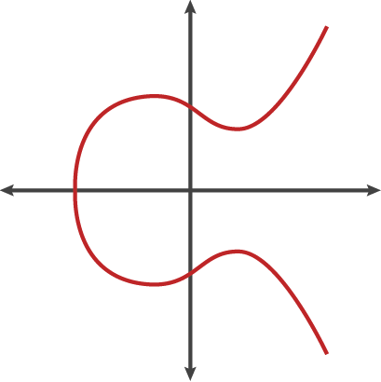
Elliptic Curve Cryptography
E: Fp
Q = s.P
P
Given P, Q and E, find s

Slide 6
Elliptic Curve Cryptography
A technique used to realize public-key cryptography based on algebraically structured elliptic curve over finite fields[1].
Most prevalent form of public-key cryptography used today given its short key sizes.
Security is based on the hardness of reversing the computation of a scalar multiplication operation on the elliptic curve.
The scalar multiplication operation is the most computationally intensive operation in implementations of elliptic curve cryptography.

Slide 7
Scalar Multiplication
Security of ECC schemes hinge on the secrecy of the scalar used for multiplication and thus the scalar/key multiplication becomes a natural target for side-channel attacks.
These algorithms typically use Multiply and Add style algorithms which process the secret scalar bit-wise[2].

Slide 8
Scalar Multiplication
Thus, attacks typically try to observe the behaviour of the implementation based on how each key bit is processed.
Montgomery’s ladder[3], Joye’s ladder[4] and Unified formulas[5] are two well known side-channel resistant approaches towards scalar multiplication.

Slide 9
Description of Attack:
Target operation: scalar multiplication.
Attack is performed in an almost “Black box” setting, wherein an attacker assumes very little information if not none about the target.
Attack works in two phases: Profiling and Attack. Works by recovering one key bit at a time.
Profiling Phase is used to perform feature selection to recover PoI (Points of Interest) on the trace that directly depend on the key bit.
For a given trace to attack, data from identified PoI are combined in such a way so as to decide on the key bit.

Slide 10
Profiling Phase:
Attacker queries device based on keys of his choice.
For a given key bit ki, the attacker partitions the collected traces corresponding to processing of ki into two sets (ki = 0 and ki = 1).
Univariate Welch’s t-test is performed over the two classes.
Detects any difference in processing of the key bit and it directly shows up as a high t-test value.
Detection of “Key-Dependent Leakage”

Slide 11
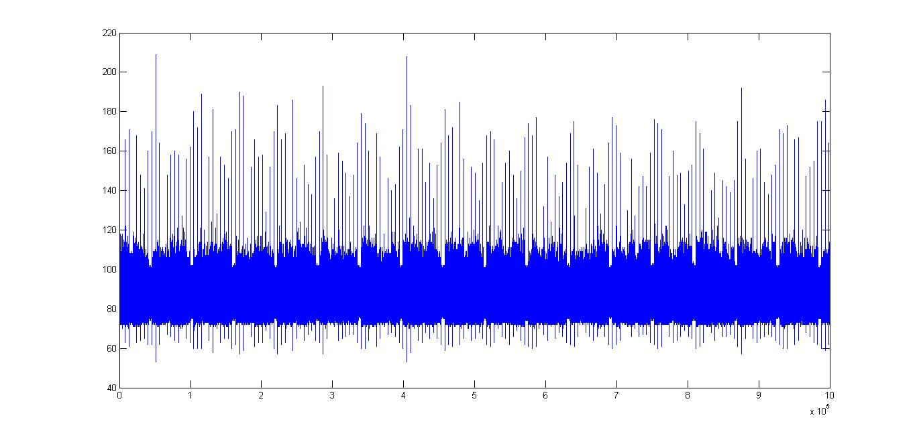
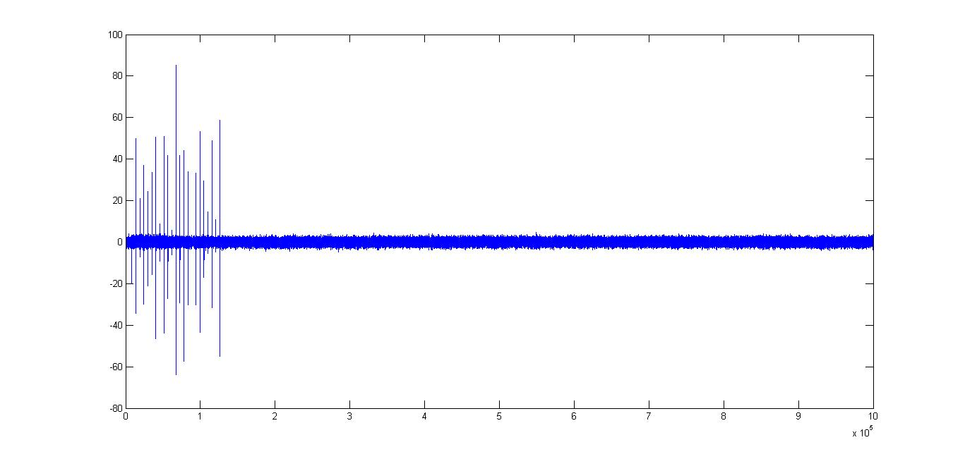
Profiling Phase:
Key bit 9
Collect traces for scalars of your choice (Attacker Assumption)
If we want to find PoI of scalar bit 9, partition traces according to value of key bit 9.
Apply Welsh’s t-test
Points with either positive or negative t-test value are chosen.
Indices with t-test value > 5
are chosen as PoI

Slide 12
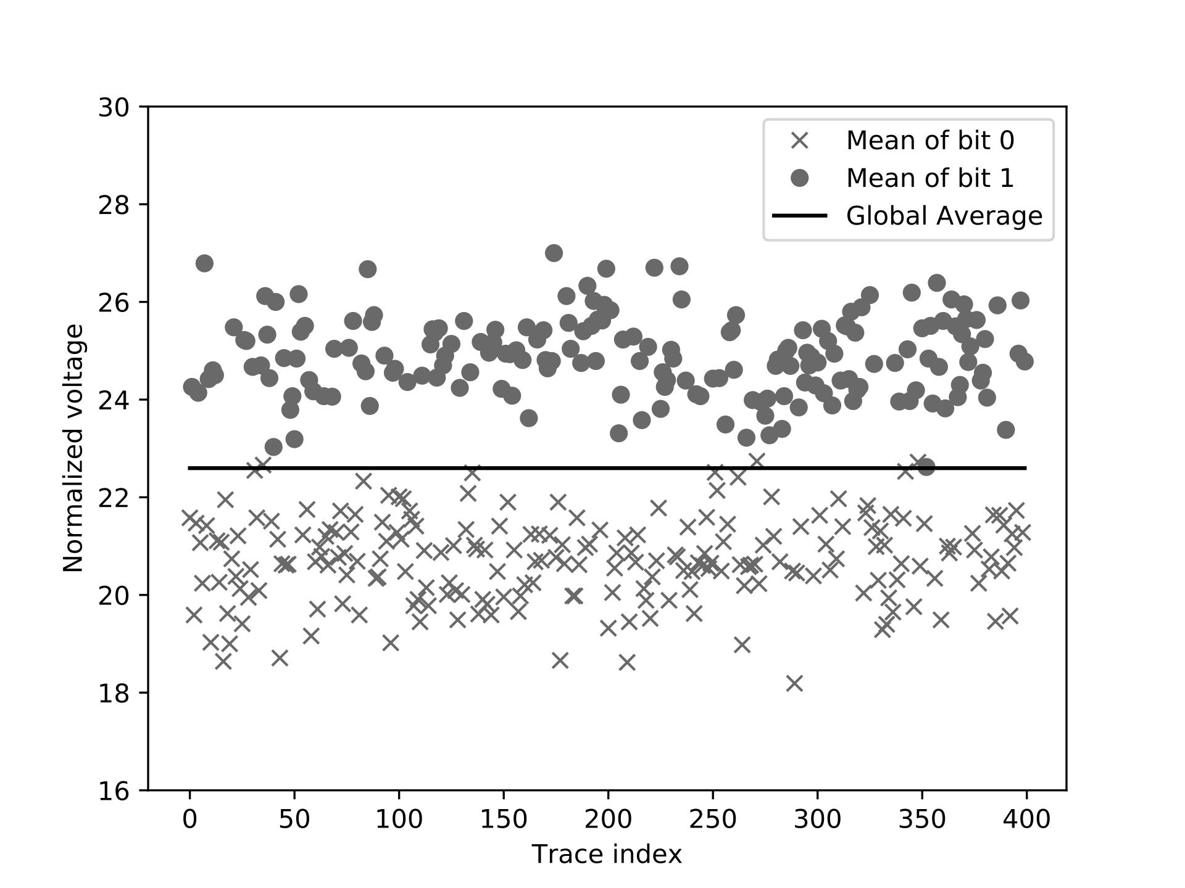
Profiling Phase:
Once the PoI are identified, for each profiled trace ti, the mean of all the data corresponding to PoI are calculated as mi
For all the traces ti in both the sets, we plot the mi and we observe a very good clustering for key bit classes 0 and 1.
Global
Threshold !!!

Slide 13
Advantages of Profiling Phase:
Knowledge of position of key bit not required.
Feature selection done to reduce data complexity of attack.
Profiling works with minimal attacker assumptions.
Even if leakage is very minimal, collecting scalars corresponding to many traces will result in high t-test value.

Slide 14
Attack Phase:
Single trace attack.
For a given trace t and profiled threshold th, we calculate the mean of the data points corresponding to PoI as m.
The decision on the value of key bit is taken depending on the difference between m and th.
If(m > th):
key_bit = 1
Else:
key_bit = 0

Slide 15
Attack targets:
We demonstrate our attack on two targets.
Hardware Target: Custom Hardware Implementation of Twisted Edwards curve (Ed25519) scalar multiplication.
Based on Virtex-5 FPGA on SASEBO G-II board.
Software Target: μNacl (Curve25519) – The Networking and Cryptographic library for 8-bit AVR ATmega microcontrollers.
Based on the Arduino Mega2560.

Slide 16
Trace Acquisition:
Clock frequency of hardware target: 24 MHz.
Measurements were captured using a near field probe from RISCURE equipped with a 3-stage active differential amplifier with 1 GHz bandwidth.
Sampling Rate: 500 Msam/sec.
Sensitivity of EM probe = 100mV/1µT@1MHz.
Traces were captured over the decoupling capacitor marked C40 on the SASEBO G-II board.

Slide 17
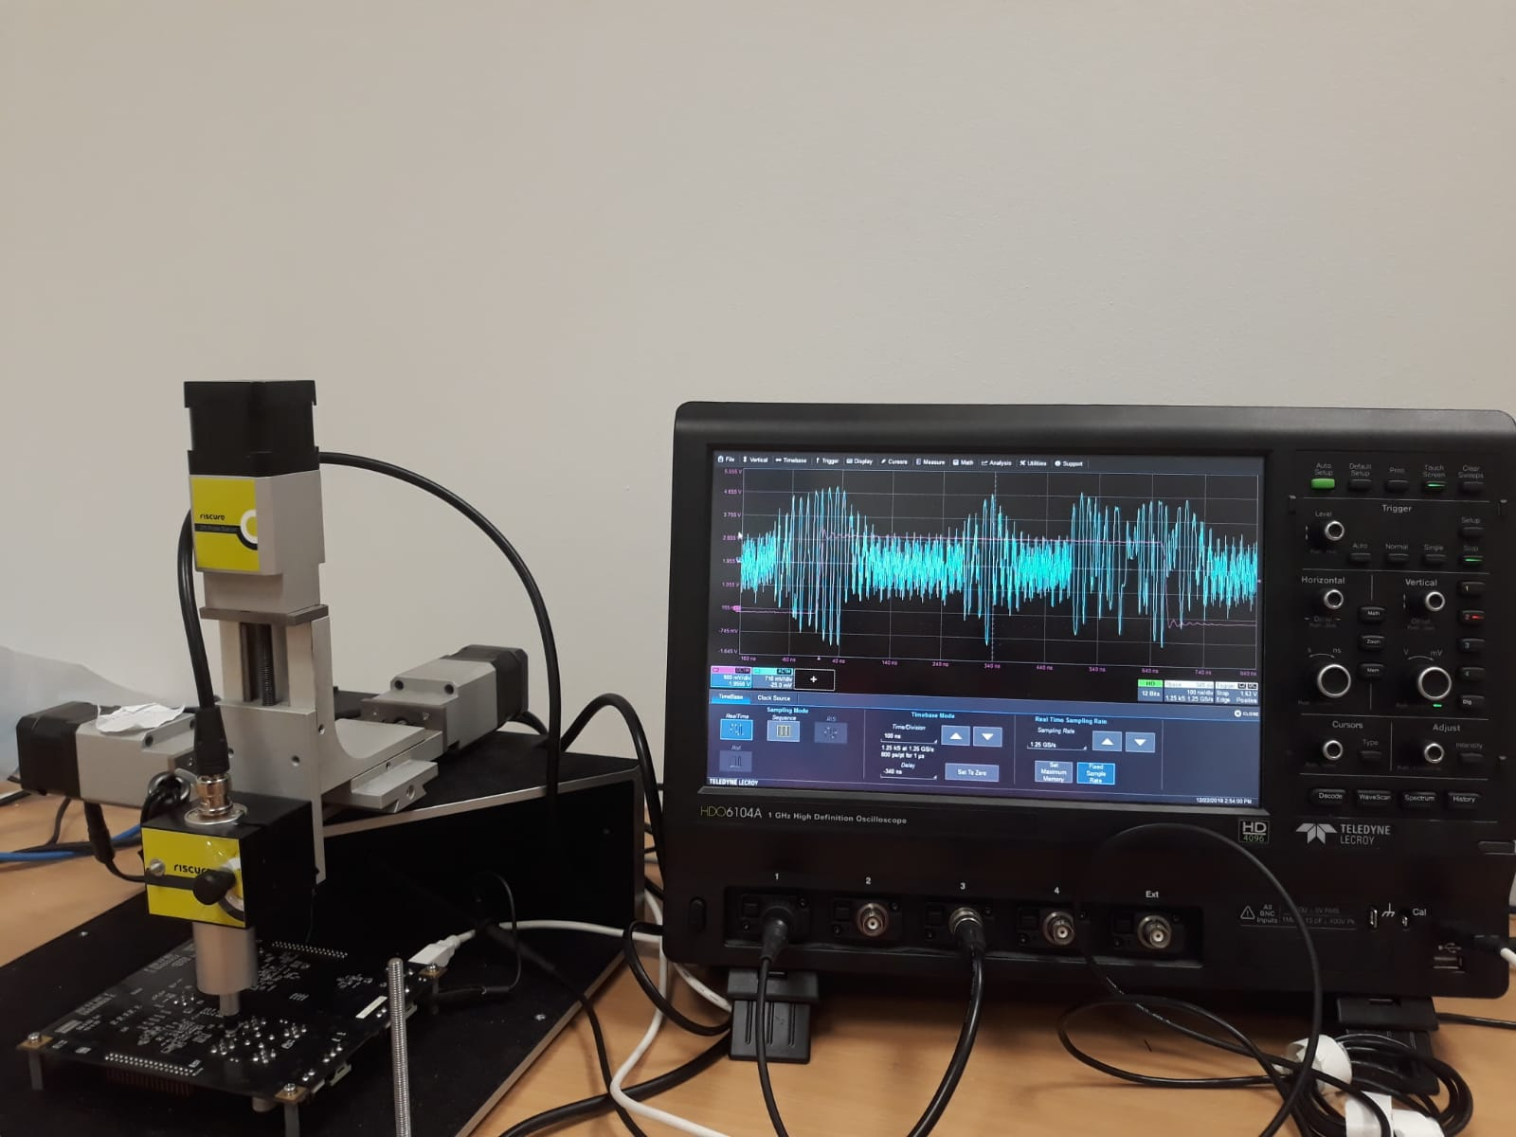
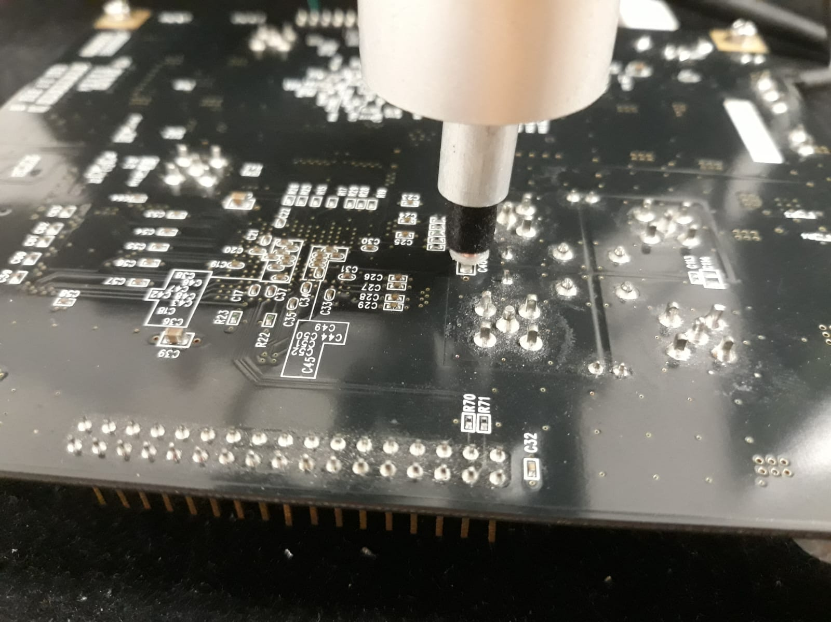
Trace Acquisition:
(a) Experimental Setup
(b) Close-up view of EM probe over the C40 decoupling capacitor

Slide 18
Hardware target:
Joye’s ladder implementation of Twisted Edwards Curve Scalar multiplication.
Points are represented in extended projective coordinates.
Unified addition algorithm used for implementation of both addition and doubling.
Implementation protected by all well known algorithmic countermeasures.
Scalar Blinding
Point Randomization
Point Re-randomization

Slide 19
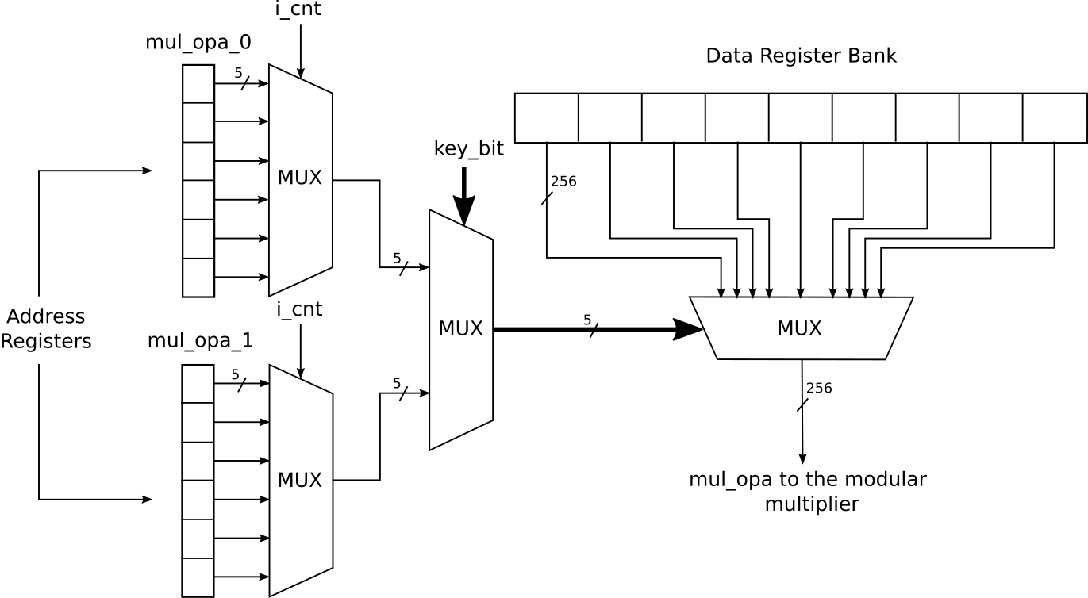
Hardware Target:
Key Dependent leakage: Order of access for operands in register is different depending on the value of key bit.
We have a multiplexer which decides the address for access whose select line is connected to the key bit.
This address selection happens before every finite field operation corresponding to every scalar/key bit.
Hence, we have 22 sources of leakage corresponding to each bit(11 for point-addition and 11 for point-doubling).

Slide 20
Key bit 9

Slide 21
Software Target:
Montgomery ladder implementation of Curve25519 scalar multiplication
Points are represented in extended coordinates.
Unified addition algorithm used for implementation of both addition and doubling.
Key Dependent Leakage: Conditional swap done among working data values based on the value of the key bits.

Slide 22
Software Target:
Swapping is done using logical operations (bitwise-xor and bitwise-and)
Swap_registers(uint_8 dst[32], uint_8 src[32], uint_8 swap)
{
swap = mask;
mask = -mask; // If mask = 0x00 or 0xFF
for(i=0;i<32;i++)
dst[i] = dst[i] ⊕ mask & (src[i] ⊕ dst[i])
}
Partitioning should be done based on equality condition of consecutive bits.
_{Work[1]}
_{Work[2]}
_{Work[3]}
_{Work[4]}
Swap if consecutive bits are different (i.e) (ki ⊕ ki-1) = 1
Do not swap if consecutive bits are the same (i.e) (ki ⊕ ki-1) = 0

Slide 23
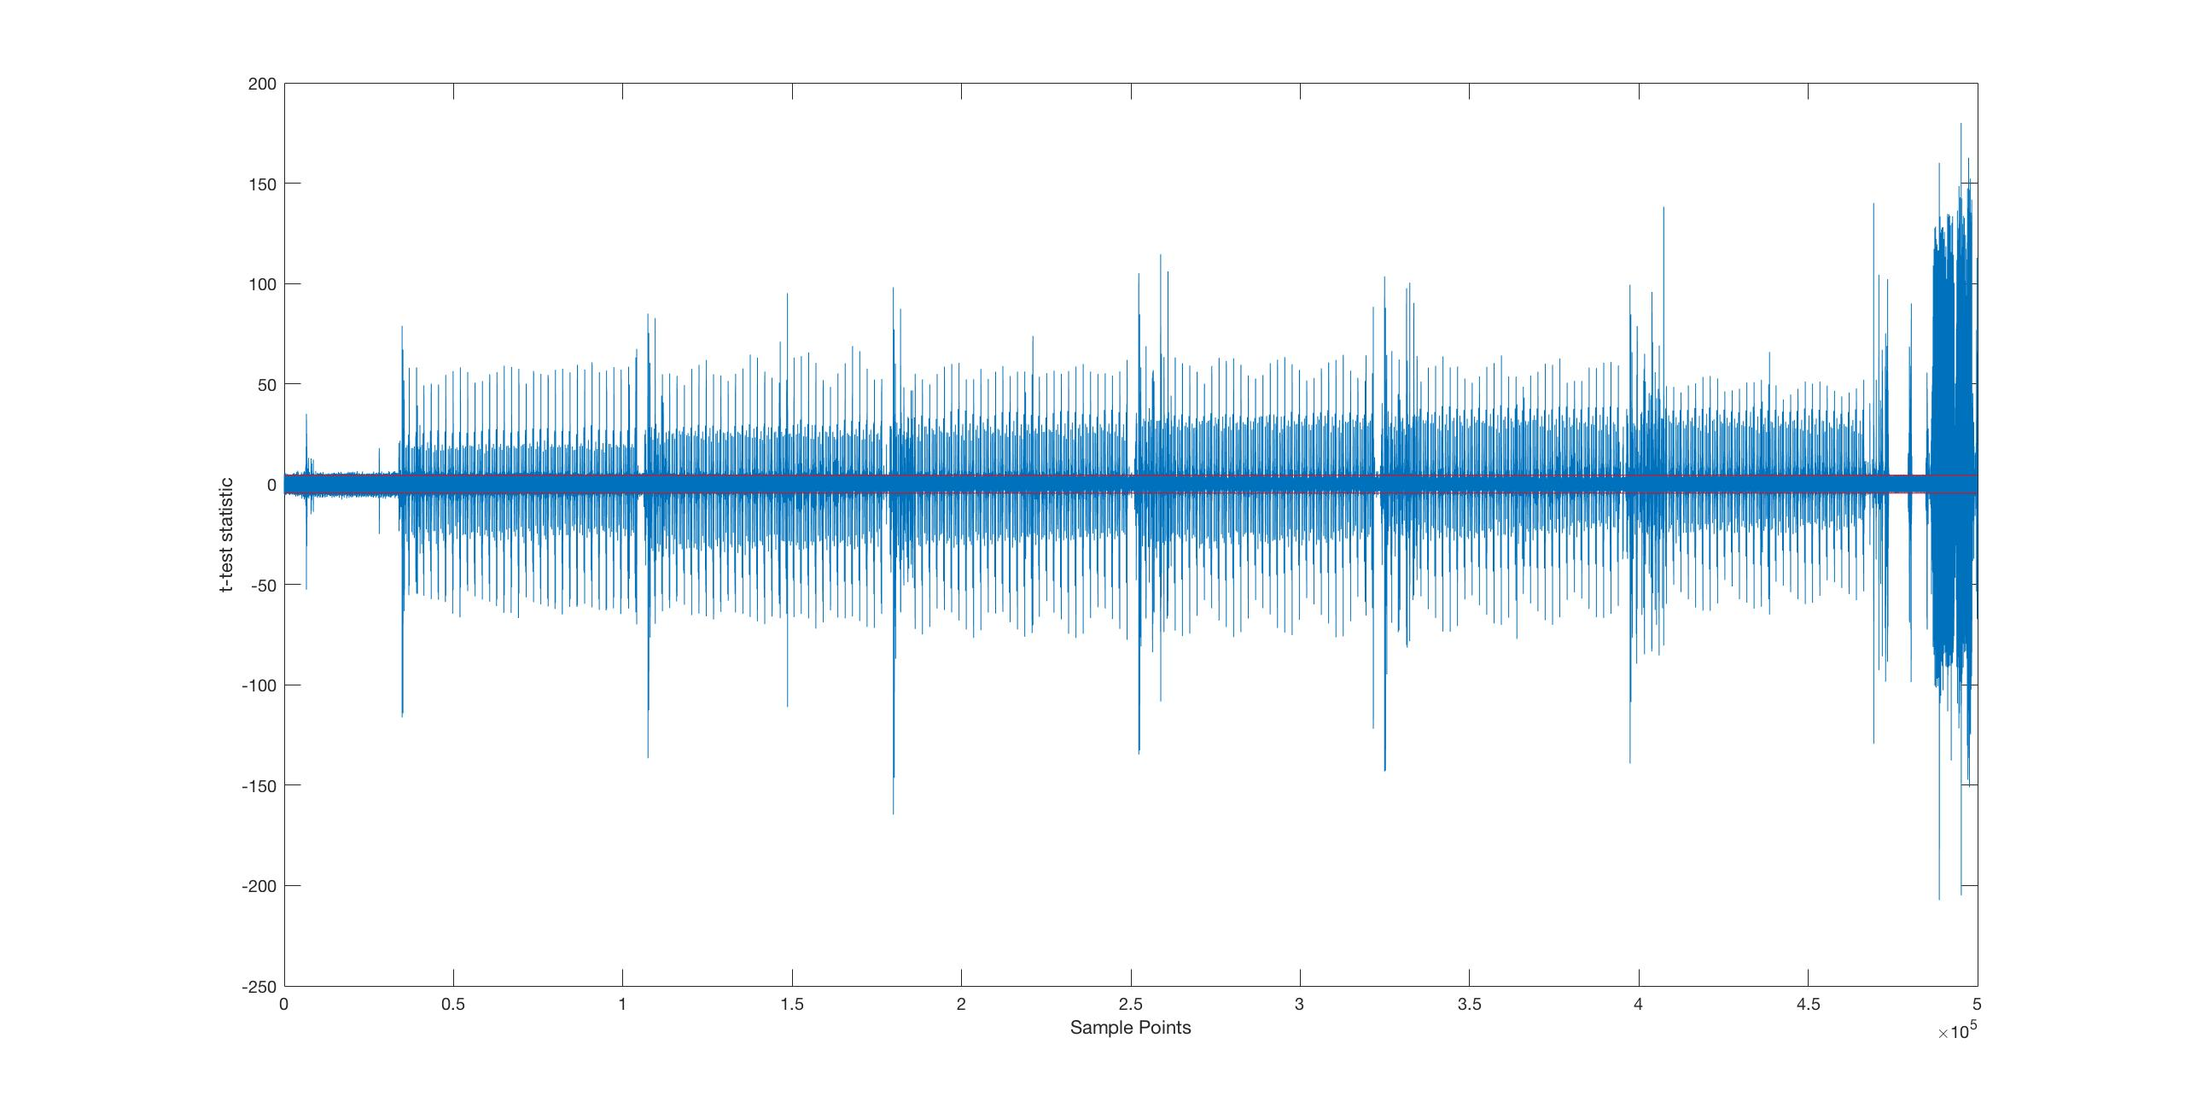
CMOV operation
1
2
3
4
5
6

Slide 24
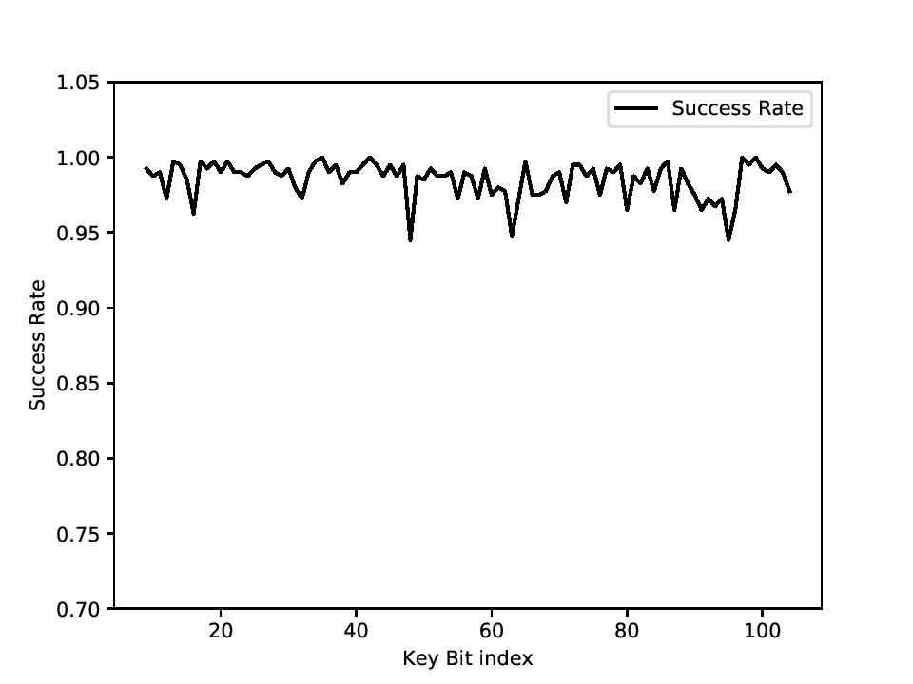
Attacking Unprotected Implementation:
Most of the implementations are regular to protect against trivial SPA and timing attacks. Hence PoI across multiple bits are the same.
Profiling one bit is enough to mount attack on the entire scalar.
We use Bit 9 for profiling and attack 96 more bits.
Success rate of 99 percent achieved over unprotected implementation.

Slide 25
Defeating Algorithmic countermeasures:
We demonstrate our attack against three well known countermeasures: Scalar Blinding (SB), Randomized Projective Co-ordinates (RPC), Re-randomized Projective Co-ordinates (RRPC).
Only key dependent leakage exploited, hence data randomization countermeasures (RPC and RRPC) do not protect against our attack.
Full scalar blinding (SB) provides protection against our attack.
But, in an insufficiently blinded implementation with short blinding factor, we will still be able to perform the attack.
One unblinded bit is enough to mount our attack.

Slide 26
Defeating Algorithmic countermeasures:
Secret Scalar K, Blinding Factor B, Group Order G.
T = G x B + K
G = 2^(252) + 27742317777372353535851937790883648493 (Only 127 LSB bits are non zero).
For a 255 bit scalar, minimum blinding factor required to corrupt all the keys is 128.
We used a blinding factor of 32 and hence 96 LSB bits are left un-blinded.
1
127
127
G
32
B
X
32
96
159
K
T
UNBLINDED!!

Slide 27
Defeating Algorithmic countermeasures:
For a 255 bit scalar, minimum blinding factor required to corrupt all the keys is 128.
We used a blinding factor of 32 and hence 96 LSB bits are left un-blinded.
Hence, we profile the 200th bit of scalar which is un-blinded to attack the other blinded bits.

Slide 28
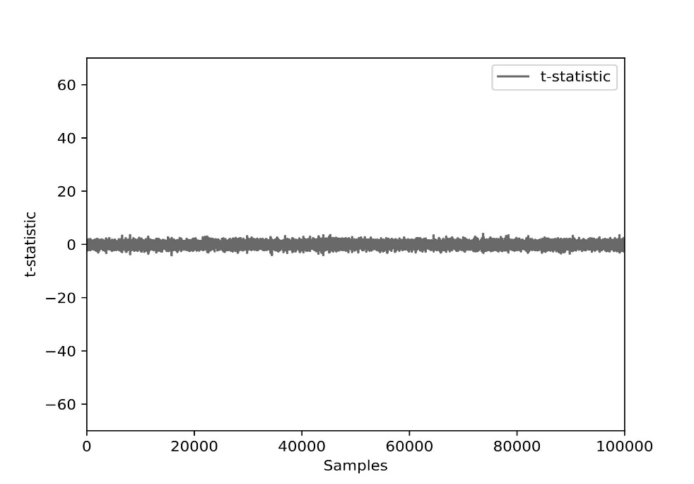
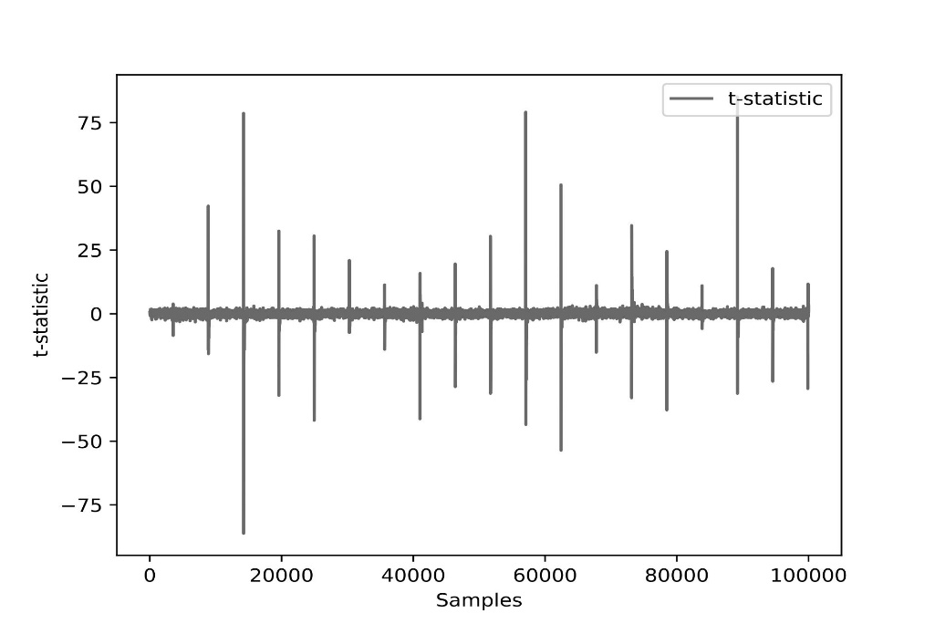
Defeating Algorithmic countermeasures:
t-test for blinded bit 4
t-test for non-blinded bit 200

Slide 29
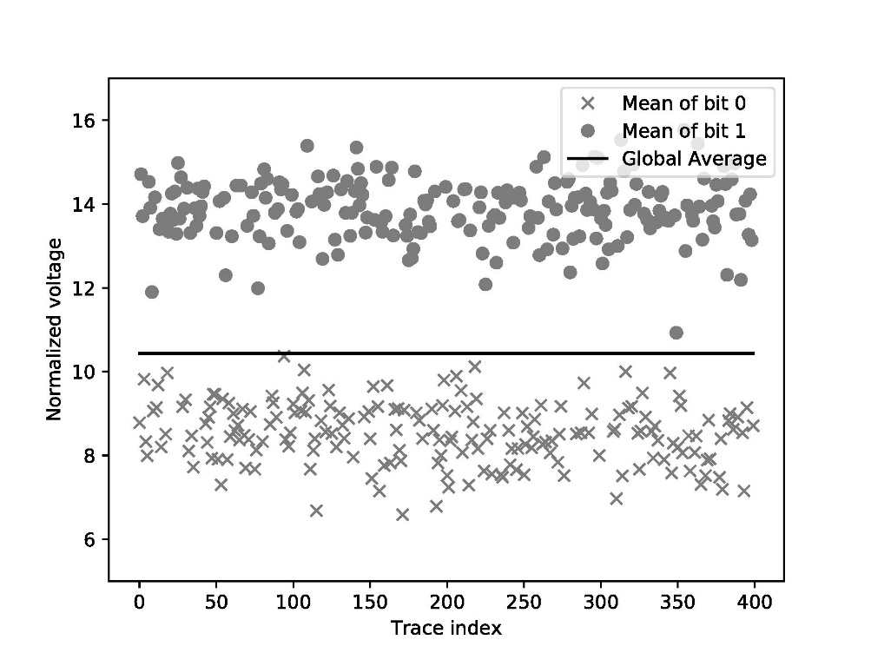
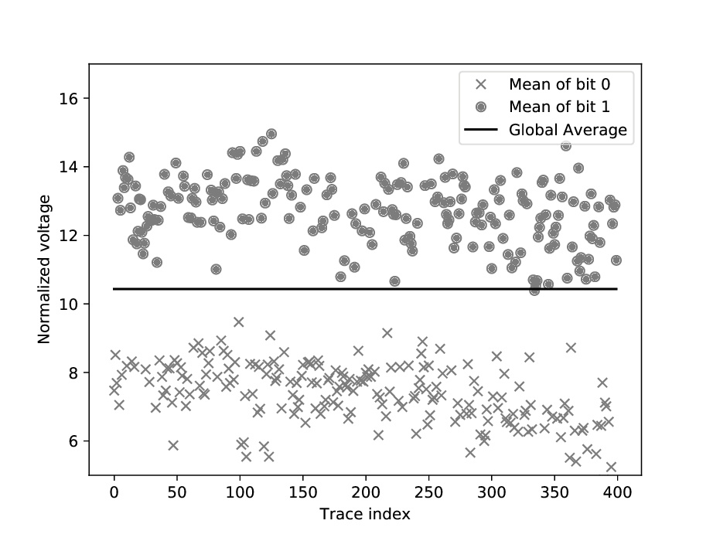
Defeating Algorithmic countermeasures:
clustering for blinded bit 4
clustering for non-blinded bit 200

Slide 30
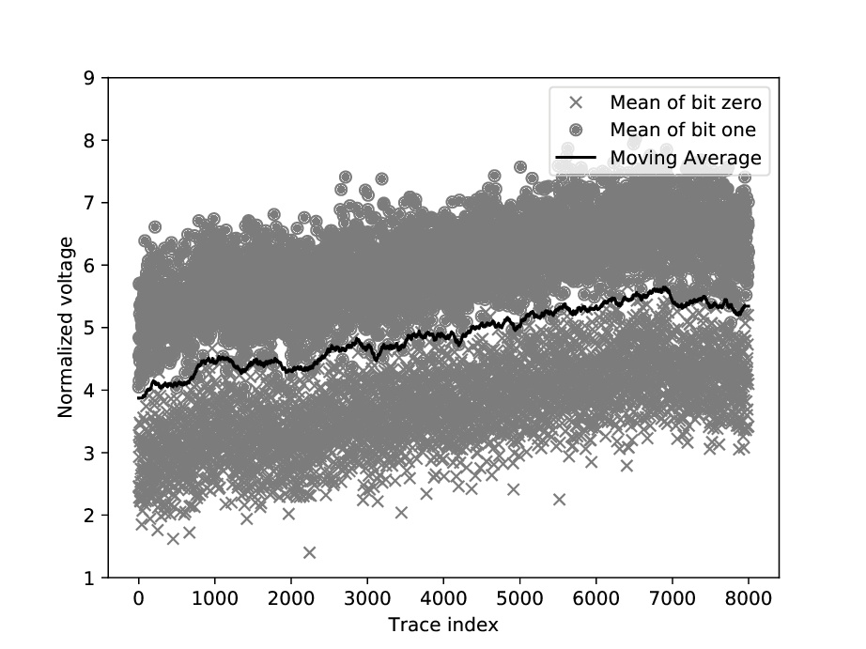
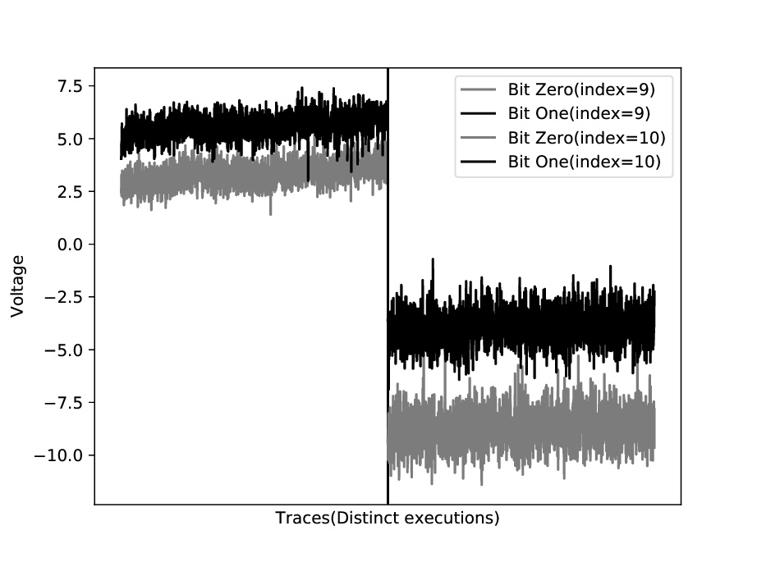
Countering varying conditions:
Variations might occur due to environmental effects, different device used for profiling and for attack, different probe position etc.
Global Threshold

Slide 31
Countering varying conditions:
Instead of using the global threshold, we track the changing threshold using moving average.
We collect multiple traces(n) to attack instead of a single trace attack and dynamically determine the attack threshold.
Given that we will have equal or approximate number of bits with both values(0/1), we take the mean of all the corresponding mi over a fixed window (w) covering the whole window.

Slide 32
Countering varying conditions:
Window

Slide 33
Countermeasures:
Small noise source is sufficient to decrease success rate of attack, since it is a single trace attack.
Jitter based countermeasures could be effective, as we target univariate leakage during profiling.
Direct manipulation of bits in implementation should be avoided to prevent key dependent leakage.

Slide 34
Future Directions:
Attack on fully blinded scalar needs to be investigated.
Attack in a non-profiled setting (Paper titled “Feature Selection Methods for Non-Profiled Side-Channel Attacks on ECC in IEEE DSP-2018).
Merely averaging PoI might not be the most optimal technique. Hence, we can use other techniques like weighted linear combination or PCA etc.
Attack on other publicly available implementations should be investigated.

Slide 35
Conclusions:
We present a generic attack based on clustering in an almost “Black Box” setting.
We identify the PoI of each bit and try to combine them in a meaningful way to extract information about bit.
Our attack works against well known algorithmic countermeasures.
We also develop various techniques increase success rate in varying environmental conditions.
An interesting future direction would be to extend our attack to complete scalar blinding.

Slide 36
THANK YOU !!!

